Slide 1
Token-Based User Authentication
Overview | JSON Web Tokens | JWT-Simple Module | Using Database | Storing JWT in Local Storage
Notes:
Welcome to our lecture on token-based user authentication. In this lecture we will go the overview, JSON web tokens, JWT-simple module, authentication using database, sorting JWT in local storage. Let’s start the video lecture.

Slide 2

Overview
User authentication verifies a user's identity.
Usernames & passwords are the most common method.
Token-based authentication uses signed tokens for verification.
Signed tokens are created with a secret key to identify users.
Notes:
Let’s talk about verifying user identity. The most common method relies on credentials like names and secret codes. A more secure approach uses unique digital keys that confirm identity without storing sensitive information. These keys are generated and verified using a hidden process, ensuring safe and efficient access to protected resources.

Slide 3
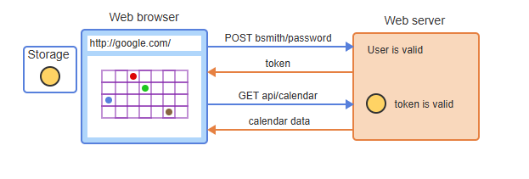
Token-based authentication process
Notes:
Now that we have introduced secure authentication, let’s explore how the system verifies users. When a user logs in, a unique key is generated and sent back. This key is stored and used to access protected information without needing repeated verification. The system checks the key’s validity with each request, ensuring only authorized users can retrieve sensitive data.

Slide 4
JSON Web Tokens (JWT)
JWT (JSON Web Token) is used in token-based authentication.
JWT structure: Header.Payload.Signature.
Signed with a secret key to prevent tampering.
Base64 encoding converts JSON data into a compact string.
Notes:
Now that we have seen how authentication works, let’s explore a common method for securing access. This approach packages user details into a compact, encoded format. To ensure security, the data is sealed with a hidden key, preventing unauthorized changes. This method allows systems to verify identity efficiently without requiring direct access to stored credentials.

Slide 5
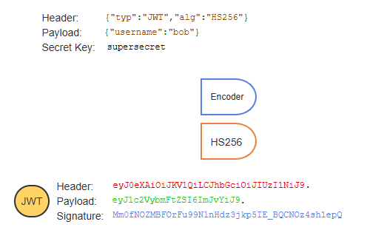
Example
Notes:
Now that we have introduced a secure way to verify identity, let’s look at how the process works. The system takes user details and encodes them into a structured format. A unique signature is added to ensure the data remains unchanged. When a request is made, the system checks the signature to confirm authenticity, allowing access only if the information is valid.

Slide 6
jwt-simple module
jwt-simple module encodes and decodes JWTs in Node.js.
Install with npm install jwt-simple.
jwt.encode() creates a JWT, jwt.decode() decodes a JWT.
Notes:
Now that we have explored how secure identity verification works, let’s look at how it is implemented. A system is used to create and validate unique digital keys, ensuring that data remains protected. This process encodes user details into a structured format and allows the system to verify authenticity when needed. This approach helps maintain security while enabling efficient access control.

Slide 7
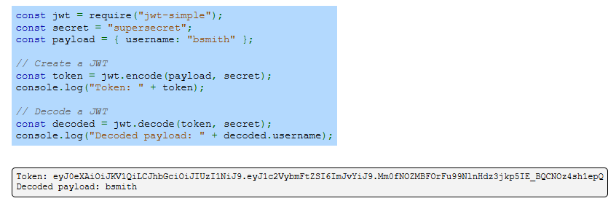
Example
Notes:
Now that we have introduced how secure tokens work, let’s look at an example of how they are created and verified. A unique key is generated using encoded user details, which can later be decoded to confirm identity. This method ensures that only authorized users can access protected resources while preventing unauthorized modifications to the stored information.

Slide 8
Using a database
User model stores username, password, and status in MongoDB.
POST /api/user adds a new user to the database.
POST /api/auth verifies credentials and returns a JWT.
GET /api/status validates JWT and returns all users' usernames & statuses.
Notes:
Now that we understand secure authentication, let’s explore how user information is managed. When a new user registers, their details are securely stored. During login, the system verifies credentials and grants access by issuing a unique key. This key is then used to retrieve user details when needed, ensuring only authorized users can access protected information.

Slide 9
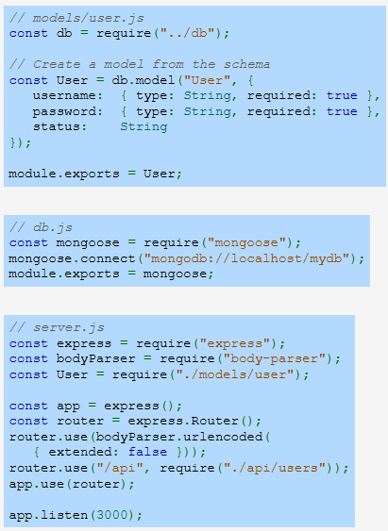
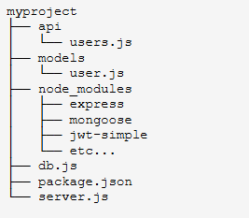
Example
Notes:
Now that we have discussed how user data is managed, let’s look at how it is structured within the system. The database stores user details in a well-organized format, ensuring security and accessibility. The server processes requests, verifies user credentials, and retrieves data when necessary. This setup allows smooth authentication and secure handling of user information.

Slide 10
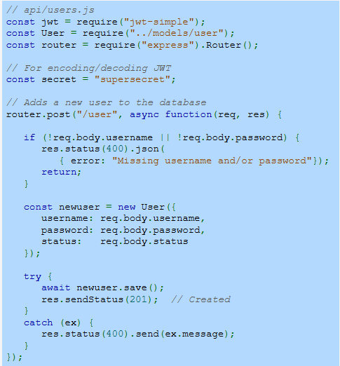
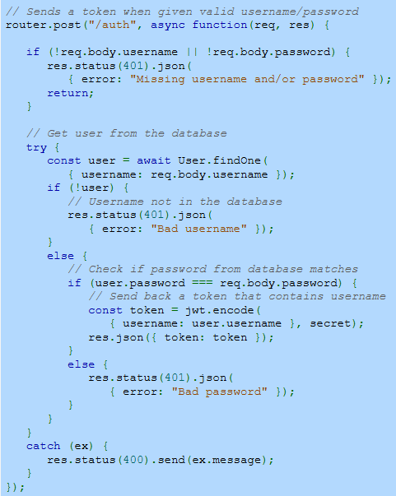
Example (Continue)
Notes:
Now that we understand how authentication works, let’s take a look at how it’s implemented in the system. The process starts by adding a new user to the database. The system securely stores credentials using hashing before saving them. This ensures passwords are never stored in plain text. Once the user is created, they can log in to receive a token.

Slide 11
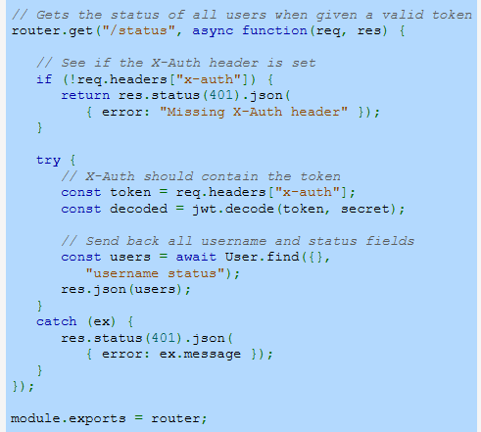
Example (Continue)
Notes:
Continuing with the implementation, when a user provides valid login details, the system checks the stored hashed password. If it matches, a token is generated and sent back to the client. This token acts as proof of authentication. Instead of sending credentials again, the client includes this token in future requests to access protected resources.

Slide 12
Storing JWT in localStorage
JWT is stored in localStorage for web app authentication.
Fetch API is used to obtain and send the JWT.
JWT is included in API requests for authentication.
Notes:
Transitioning from token authentication, let’s discuss how tokens are stored in a web application. The system saves tokens in storage, allowing users to remain authenticated without re-entering credentials. The application retrieves and includes the token in requests to access protected resources. This approach ensures smooth interactions while maintaining authentication security.

Slide 13
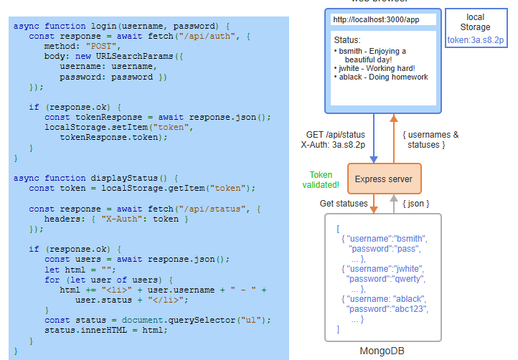
Example
Notes:
Building on how tokens are stored, let's look at how they are used in a web application. The system sends authentication details, receives a token, and saves it. When making future requests, the token is retrieved and included for validation. The server checks its authenticity before granting access to protected data. This method ensures secure and efficient user authentication.

